Slide 1

Essential Respiratory Review
Vocabulary
Numbers Review
Airway, Ventilation, Oxygenation
Respiratory Distress vs. Failure
Common Respiratory Emergencies
Common Breath Sounds
Practice Questions
NREMT Review

Slide 2

Vocabulary Review
Angina
Myocardial Infarction (MI)
Perfusion
Cardiac Output
Stroke Volume
Bradycardia

Slide 3
Vocabulary Review
Angina | Chest pain or discomfort caused by reduced blood flow to the heart muscle.
Myocardial Infarction (MI)
Perfusion
Cardiac Output
Stroke Volume
Bradycardia

Slide 4
Vocabulary Review
Angina | Chest pain or discomfort caused by reduced blood flow to the heart muscle.
Myocardial Infarction (MI) | Death of heart muscle tissue due to prolonged lack of blood flow; a heart attack.
Perfusion
Cardiac Output
Stroke Volume
Bradycardia

Slide 5
Vocabulary Review
Angina | Chest pain or discomfort caused by reduced blood flow to the heart muscle.
Myocardial Infarction (MI) | Death of heart muscle tissue due to prolonged lack of blood flow; a heart attack.
Perfusion | The circulation of blood through tissues to deliver oxygen and nutrients.
Cardiac Output
Stroke Volume
Bradycardia

Slide 6
Vocabulary Review
Angina | Chest pain or discomfort caused by reduced blood flow to the heart muscle.
Myocardial Infarction (MI) | Death of heart muscle tissue due to prolonged lack of blood flow; a heart attack.
Perfusion | The circulation of blood through tissues to deliver oxygen and nutrients.
Cardiac Output | The amount of blood pumped by the heart in one minute.
Stroke Volume
Bradycardia

Slide 7
Vocabulary Review
Angina | Chest pain or discomfort caused by reduced blood flow to the heart muscle.
Myocardial Infarction (MI) | Death of heart muscle tissue due to prolonged lack of blood flow; a heart attack.
Perfusion | The circulation of blood through tissues to deliver oxygen and nutrients.
Cardiac Output | The amount of blood pumped by the heart in one minute.
Stroke Volume | The amount of blood ejected by the left ventricle with each heartbeat.
Bradycardia

Slide 8
Vocabulary Review
Angina | Chest pain or discomfort caused by reduced blood flow to the heart muscle.
Myocardial Infarction (MI) | Death of heart muscle tissue due to prolonged lack of blood flow; a heart attack.
Perfusion | The circulation of blood through tissues to deliver oxygen and nutrients.
Cardiac Output | The amount of blood pumped by the heart in one minute.
Stroke Volume | The amount of blood ejected by the left ventricle with each heartbeat.
Bradycardia | Heart rate less than 60 beats per minute in an adult.

Slide 9
Vocabulary Review
Tachycardia
Syncope
Cardiogenic Shock
Hypovolemic Shock
Septic Shock
Obstructive Shock
Compensated Shock
Decompensated Shock

Slide 10
Vocabulary Review
Tachycardia | Heart rate greater than 100 beats per minute in an adult.
Syncope
Cardiogenic Shock
Hypovolemic Shock
Septic Shock
Obstructive Shock
Compensated Shock
Decompensated Shock

Slide 11
Vocabulary Review
Tachycardia | Heart rate greater than 100 beats per minute in an adult.
Syncope | Temporary loss of consciousness caused by decreased blood flow to the brain; fainting.
Cardiogenic Shock
Hypovolemic Shock
Septic Shock
Obstructive Shock
Compensated Shock
Decompensated Shock

Slide 12
Vocabulary Review
Tachycardia | Heart rate greater than 100 beats per minute in an adult.
Syncope | Temporary loss of consciousness caused by decreased blood flow to the brain; fainting.
Cardiogenic Shock | Shock caused by the heart's inability to pump blood effectively.
Hypovolemic Shock
Septic Shock
Obstructive Shock
Compensated Shock
Decompensated Shock

Slide 13
Vocabulary Review
Tachycardia | Heart rate greater than 100 beats per minute in an adult.
Syncope | Temporary loss of consciousness caused by decreased blood flow to the brain; fainting.
Cardiogenic Shock | Shock caused by the heart's inability to pump blood effectively.
Hypovolemic Shock | Shock caused by significant loss of blood or body fluids.
Septic Shock
Obstructive Shock
Compensated Shock
Decompensated Shock

Slide 14
Vocabulary Review
Tachycardia | Heart rate greater than 100 beats per minute in an adult.
Syncope | Temporary loss of consciousness caused by decreased blood flow to the brain; fainting.
Cardiogenic Shock | Shock caused by the heart's inability to pump blood effectively.
Hypovolemic Shock | Shock caused by significant loss of blood or body fluids.
Septic Shock | Shock caused by a severe infection leading to widespread vasodilation and poor perfusion.
Obstructive Shock
Compensated Shock
Decompensated Shock

Slide 15
Vocabulary Review
Tachycardia | Heart rate greater than 100 beats per minute in an adult.
Syncope | Temporary loss of consciousness caused by decreased blood flow to the brain; fainting.
Cardiogenic Shock | Shock caused by the heart's inability to pump blood effectively.
Hypovolemic Shock | Shock caused by significant loss of blood or body fluids.
Septic Shock | Shock caused by a severe infection leading to widespread vasodilation and poor perfusion.
Obstructive Shock | Shock caused by a physical obstruction preventing adequate circulation (e.g., tension pneumothorax, cardiac tamponade).
Compensated Shock
Decompensated Shock

Slide 16
Vocabulary Review
Tachycardia | Heart rate greater than 100 beats per minute in an adult.
Syncope | Temporary loss of consciousness caused by decreased blood flow to the brain; fainting.
Cardiogenic Shock | Shock caused by the heart's inability to pump blood effectively.
Hypovolemic Shock | Shock caused by significant loss of blood or body fluids.
Septic Shock | Shock caused by a severe infection leading to widespread vasodilation and poor perfusion.
Obstructive Shock | Shock caused by a physical obstruction preventing adequate circulation (e.g., tension pneumothorax, cardiac tamponade).
Compensated Shock | Early stage of shock in which the body maintains blood pressure through compensatory mechanisms.
Decompensated Shock

Slide 17
Vocabulary Review
Tachycardia | Heart rate greater than 100 beats per minute in an adult.
Syncope | Temporary loss of consciousness caused by decreased blood flow to the brain; fainting.
Cardiogenic Shock | Shock caused by the heart's inability to pump blood effectively.
Hypovolemic Shock | Shock caused by significant loss of blood or body fluids.
Septic Shock | Shock caused by a severe infection leading to widespread vasodilation and poor perfusion.
Obstructive Shock | Shock caused by a physical obstruction preventing adequate circulation (e.g., tension pneumothorax, cardiac tamponade).
Compensated Shock | Early stage of shock in which the body maintains blood pressure through compensatory mechanisms.
Decompensated Shock | Late stage of shock in which compensatory mechanisms fail and blood pressure drops.

Slide 18
Vocabulary Review
Diaphoresis
Nitroglycerin
Aspirin
Defibrillation
AED (Automated External Defibrillator)
Hemiplegia

Slide 19
Vocabulary Review
Diaphoresis | Excessive sweating, often associated with shock or cardiac emergencies.
Nitroglycerin
Aspirin
Defibrillation
AED (Automated External Defibrillator)
Hemiplegia

Slide 20
Vocabulary Review
Diaphoresis | Excessive sweating, often associated with shock or cardiac emergencies.
Nitroglycerin | Medication used to dilate blood vessels and relieve cardiac chest pain.
Aspirin
Defibrillation
AED (Automated External Defibrillator)
Hemiplegia

Slide 21
Vocabulary Review
Diaphoresis | Excessive sweating, often associated with shock or cardiac emergencies.
Nitroglycerin | Medication used to dilate blood vessels and relieve cardiac chest pain.
Aspirin | Medication that helps prevent platelets from forming clots during a suspected heart attack.
Defibrillation
AED (Automated External Defibrillator)
Hemiplegia

Slide 22
Vocabulary Review
Diaphoresis | Excessive sweating, often associated with shock or cardiac emergencies.
Nitroglycerin | Medication used to dilate blood vessels and relieve cardiac chest pain.
Aspirin | Medication that helps prevent platelets from forming clots during a suspected heart attack.
Defibrillation | Delivery of an electrical shock to stop certain life-threatening cardiac arrhythmias.
AED (Automated External Defibrillator)
Hemiplegia

Slide 23
Vocabulary Review
Diaphoresis | Excessive sweating, often associated with shock or cardiac emergencies.
Nitroglycerin | Medication used to dilate blood vessels and relieve cardiac chest pain.
Aspirin | Medication that helps prevent platelets from forming clots during a suspected heart attack.
Defibrillation | Delivery of an electrical shock to stop certain life-threatening cardiac arrhythmias.
AED (Automated External Defibrillator) | Device that analyzes heart rhythm and delivers a shock if indicated.
Hemiplegia

Slide 24
Vocabulary Review
Diaphoresis | Excessive sweating, often associated with shock or cardiac emergencies.
Nitroglycerin | Medication used to dilate blood vessels and relieve cardiac chest pain.
Aspirin | Medication that helps prevent platelets from forming clots during a suspected heart attack.
Defibrillation | Delivery of an electrical shock to stop certain life-threatening cardiac arrhythmias.
AED (Automated External Defibrillator) | Device that analyzes heart rhythm and delivers a shock if indicated.
Hemiplegia | Paralysis on one side of the body.

Slide 25
Vocabulary Review
eclampsia
placenta previa
abruptio placentae
ectopic pregnancy

Slide 26
Vocabulary Review
eclampsia | A life-threatening condition in a pregnant woman characterized by seizures, usually occurring after preeclampsia.
placenta previa
abruptio placentae
ectopic pregnancy

Slide 27
Vocabulary Review
eclampsia | A life-threatening condition in a pregnant woman characterized by seizures, usually occurring after preeclampsia.
placenta previa | A condition in which the placenta implants over or near the cervix, often causing painless vaginal bleeding.
abruptio placentae
ectopic pregnancy

Slide 28
Vocabulary Review
eclampsia | A life-threatening condition in a pregnant woman characterized by seizures, usually occurring after preeclampsia.
placenta previa | A condition in which the placenta implants over or near the cervix, often causing painless vaginal bleeding.
abruptio placentae | Premature separation of the placenta from the uterine wall before delivery, typically causing painful vaginal bleeding and abdominal pain.
ectopic pregnancy

Slide 29
Vocabulary Review
eclampsia | A life-threatening condition in a pregnant woman characterized by seizures, usually occurring after preeclampsia.
placenta previa | A condition in which the placenta implants over or near the cervix, often causing painless vaginal bleeding.
abruptio placentae | Premature separation of the placenta from the uterine wall before delivery, typically causing painful vaginal bleeding and abdominal pain.
ectopic pregnancy | fertilized egg implants and begins to grow outside the uterus (womb), most commonly in one of the fallopian tubes.

Slide 30
Numbers Review

Slide 31
Numbers Bank
Percentage of adult head
Percentage child head
Adult CPR depth
Normal Adult Respirations
Adult CPR Rate
Normal Adult Heart Rate
NRB LPM
BVM 1 breath every ____ seconds
Normal glucose
APGAR scores at what times
nasal cannula LPM

Slide 32
Numbers Bank
Percentage for adult head | 9%
Percentage child head
Adult CPR depth
Normal Adult Respirations
Adult CPR Rate
Normal Adult Heart Rate
NRB LPM
BVM 1 breath every ____ seconds
Normal glucose
APGAR scores at what times
nasal cannula LPM

Slide 33
Numbers Bank
Percentage for adult head | 9%
Percentage child head | 18%
Adult CPR depth
Normal Adult Respirations
Adult CPR Rate
Normal Adult Heart Rate
NRB LPM
BVM 1 breath every ____ seconds
Normal glucose
APGAR scores at what times
nasal cannula LPM

Slide 34
Numbers Bank
Percentage for adult head | 9%
Percentage for one adult leg | 18%
Adult CPR depth | 2 - 2.5 inches
Normal Adult Respirations
Adult CPR Rate
Normal Adult Heart Rate
NRB LPM
BVM 1 breath every ____ seconds
Normal glucose
APGAR scores at what times
nasal cannula LPM

Slide 35
Numbers Bank
Percentage for adult head | 9%
Percentage for one adult leg | 18%
Adult CPR depth | 2 - 2.5 inches
Normal Adult Respirations | 12 - 20 breaths per minute
Adult CPR Rate
Normal Adult Heart Rate
NRB LPM
BVM 1 breath every ____ seconds
Normal glucose
APGAR scores at what times
nasal cannula LPM

Slide 36
Numbers Bank
Percentage for adult head | 9%
Percentage for one adult leg | 18%
Adult CPR depth | 2 - 2.5 inches
Normal Adult Respirations | 12 - 20 breaths per minute
Adult CPR Rate | 100 - 120 compressions/minute
Normal Adult Heart Rate
NRB LPM
BVM 1 breath every ____ seconds
Normal glucose
APGAR scores at what times
nasal cannula LPM

Slide 37
Numbers Bank
Percentage for adult head | 9%
Percentage for one adult leg | 18%
Adult CPR depth | 2 - 2.5 inches
Normal Adult Respirations | 12 - 20 breaths per minute
Adult CPR Rate | 100 - 120 compressions/minute
Normal Adult Heart Rate | 60-100 bpm
NRB LPM
BVM 1 breath every ____ seconds
Normal glucose
APGAR scores at what times
nasal cannula LPM

Slide 38
Numbers Bank
Percentage for adult head | 9%
Percentage for one adult leg | 18%
Adult CPR depth | 2 - 2.5 inches
Normal Adult Respirations | 12 - 20 breaths per minute
Adult CPR Rate | 100 - 120 compressions/minute
Normal Adult Heart Rate | 60-100 bpm
NRB LPM | 10-15 LPM
BVM 1 breath every ____ seconds
Normal glucose
APGAR scores at what times
nasal cannula LPM

Slide 39
Numbers Bank
Percentage for adult head | 9%
Percentage for one adult leg | 18%
Adult CPR depth | 2 - 2.5 inches
Normal Adult Respirations | 12 - 20 breaths per minute
Adult CPR Rate | 100 - 120 compressions/minute
Normal Adult Heart Rate | 60-100 bpm
NRB LPM | 10-15 LPM
BVM 1 breath every ____ seconds | 6 seconds
Normal glucose
APGAR scores at what times
nasal cannula LPM

Slide 40
Numbers Bank
Percentage for adult head | 9%
Percentage for one adult leg | 18%
Adult CPR depth | 2 - 2.5 inches
Normal Adult Respirations | 12 - 20 breaths per minute
Adult CPR Rate | 100 - 120 compressions/minute
Normal Adult Heart Rate | 60-100 bpm
NRB LPM | 10-15 LPM
BVM 1 breath every ____ seconds | 6 seconds
Normal glucose | 70 - 140
APGAR scores at what times
nasal cannula LPM

Slide 41
Numbers Bank
Percentage for adult head | 9%
Percentage for one adult leg | 18%
Adult CPR depth | 2 - 2.5 inches
Normal Adult Respirations | 12 - 20 breaths per minute
Adult CPR Rate | 100 - 120 compressions/minute
Normal Adult Heart Rate | 60-100 bpm
NRB LPM | 10-15 LPM
BVM 1 breath every ____ seconds | 6 seconds
Normal glucose | 70 - 140
APGAR scores at what times | 1 minute and 5 minutes
nasal cannula LPM

Slide 42
Numbers Bank
Percentage for adult head | 9%
Percentage for one adult leg | 18%
Adult CPR depth | 2 - 2.5 inches
Normal Adult Respirations | 12 - 20 breaths per minute
Adult CPR Rate | 100 - 120 compressions/minute
Normal Adult Heart Rate | 60-100 bpm
NRB LPM | 10-15 LPM
BVM 1 breath every ____ seconds | 6 seconds
Normal glucose | 70 - 140
APGAR scores at what times | 1 minute and 5 minutes
nasal cannula LPM | 1-6 LPM

Slide 43
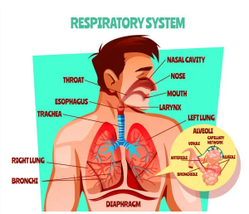
Airway

Slide 44
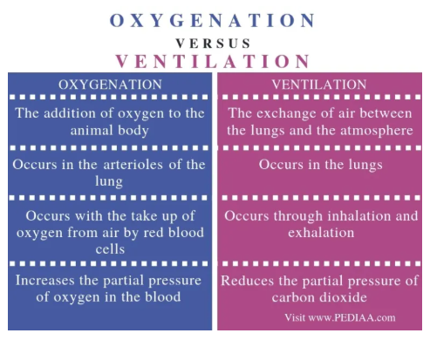
Ventilation vs. Oxygenation

Slide 45
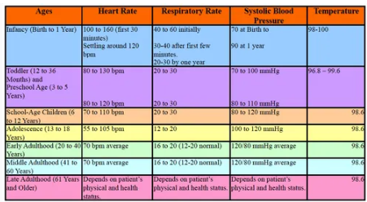
Normal Respiratory Numbers

Slide 46
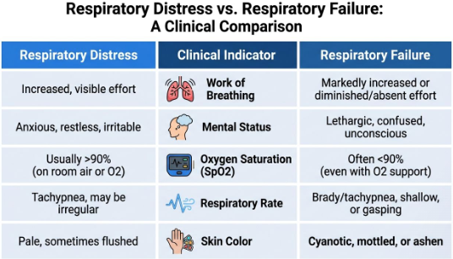
💡 A way to remember it:
Distress is the work
Failure is the consequence

Slide 47
Respiratory
Distress vs Failure
Watch for these turning points:
Speech drops off: Words become single-word answers or stop altogether.
Attention drifts: The patient is less engaged, less responsive, or oddly calm.
Chest movement changes: Less movement after prolonged effort may mean fatigue, not recovery.
Color worsens: Cyanosis or ashen appearance raises the stakes immediately.

Slide 48
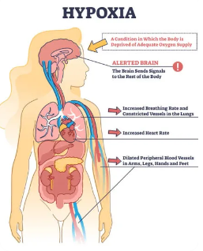
Hypoxia

Slide 49
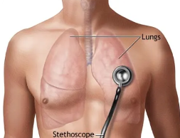
Breath Sounds

Slide 50
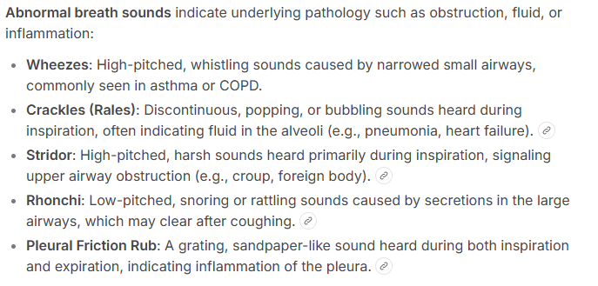
Breath Sounds

Slide 51
Breath Sounds

Slide 52
Hyperventilation vs. Hypoventilation

Slide 53
Airway Adjunct

Slide 54
Oxygen Delivery Devices

Slide 55
Respiratory Scenario #1
A 24-year-old presents with:
Wheezing
Accessory muscle use
Speaking in short sentences
Questions
Distress or failure?
Likely condition?
Treatment priorities?

Slide 56
Respiratory Scenario #1
A 24-year-old presents with:
Wheezing
Accessory muscle use
Speaking in short sentences
Questions
Distress or failure?
Likely condition?
Treatment priorities?
Answer: Respiratory distress, likely asthma.

Slide 57
Respiratory Scenario #2
A 72-year-old presents with:
Crackles
Pink frothy sputum
Dyspnea
Questions
Likely condition?
What breath sound is expected?

Slide 58
Respiratory Scenario #2
A 72-year-old presents with:
Crackles
Pink frothy sputum
Dyspnea
Questions
Likely condition?
What breath sound is expected?
Answer: Pulmonary edema, crackles.

Slide 59
Respiratory Scenario #3
A child presents with:
Barking cough
Stridor
Questions
Upper or lower airway problem?
Likely condition?

Slide 60
Respiratory Scenario #3
A child presents with:
Barking cough
Stridor
Questions
Upper or lower airway problem?
Likely condition?
Answer: Upper airway; croup.

Slide 61
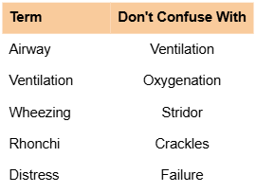
Commonly Confused Terms

Slide 62
Respiratory Memory Pearls
Wheezing = Lower airway
Stridor = Upper airway
Crackles = Fluid
Rhonchi = Secretions
Distress = Compensating
Failure = Decompensating
OPA = No gag reflex
NPA = Gag reflex present
COPD patients often wheeze
Pulmonary edema causes crackles

Slide 63
Quick Review
Define hypoxia.

Slide 64
Quick Review
Define hypoxia.
Hypoxia is inadequate oxygen delivery to the body's tissues.
Common signs:
Restlessness
Anxiety
Tachycardia
Altered mental status
Cyanosis (late)

Slide 65
Quick Review
Define cyanosis.

Slide 66
Quick Review
Define cyanosis.
Cyanosis is a bluish discoloration of the skin, lips, or nail beds caused by inadequate oxygenation.
NREMT Pearl: Cyanosis is a late sign of hypoxia.

Slide 67
Quick Review
What is stridor?

Slide 68
Quick Review
What is stridor?
Stridor is a harsh, high-pitched sound caused by upper airway obstruction.
Common causes:
Croup
Epiglottitis
Airway swelling
Foreign body obstruction

Slide 69
Quick Review
What is wheezing?

Slide 70
Quick Review
What is wheezing?
Wheezing is a high-pitched whistling sound caused by narrowing of the lower airways.
Common causes:
Asthma
COPD
Bronchospasm

Slide 71
Quick Review
What is pulmonary edema?

Slide 72
Quick Review
What is pulmonary edema?
Pulmonary edema is the accumulation of fluid in the lungs.
Signs:
Shortness of breath
Crackles (rales)
Pink frothy sputum
Common cause: Congestive heart failure (CHF)

Slide 73
Quick Review
What is COPD?

Slide 74
Quick Review
What is COPD?
COPD (Chronic Obstructive Pulmonary Disease) is a chronic lung disease that causes airflow obstruction.
Includes:
Chronic bronchitis
Emphysema
Common findings:
Wheezing
Chronic cough
Barrel chest

Slide 75
Quick Review
OPA or NPA for a patient with a gag reflex?

Slide 76
Quick Review
OPA or NPA for a patient with a gag reflex?
✅ NPA (Nasopharyngeal Airway)
Reason: NPAs can be used in patients with an intact gag reflex.
❌ OPA (Oropharyngeal Airway) is used only in unresponsive patients without a gag reflex.

Slide 77
Quick Review
Flow rate for a nonrebreather?

Slide 78
Quick Review
Flow rate for a nonrebreather?
✅ 10–15 LPM
NREMT Pearl: Most EMT textbooks teach 15 LPM to keep the reservoir bag inflated.

Slide 79
Quick Review
Signs of respiratory failure?

Slide 80
Quick Review
Signs of respiratory failure?
Late signs:
Altered mental status
Cyanosis
Exhaustion
Decreased respiratory effort
Slow or irregular respirations
Inability to speak
Poor air movement
NREMT Pearl: Respiratory failure = the patient is no longer compensating.

Slide 81
Quick Review
Difference between ventilation and oxygenation?

Slide 82
Quick Review
Difference between ventilation and oxygenation?
Ventilation Moving air in and out of the lungs. Question: "Is air moving?" | Oxygenation Getting oxygen into the bloodstream. Question: "Is oxygen reaching the blood?"

Slide 83
Quick Review
Define hypoxia.
Define cyanosis.
What is stridor?
What is wheezing?
What is pulmonary edema?
What is COPD?
OPA or NPA for a patient with a gag reflex?
Flow rate for a nonrebreather?
Signs of respiratory failure?
Difference between ventilation and oxygenation?

Slide 84
Quick Review
Define hypoxia.
Define cyanosis.
What is stridor?
What is wheezing?
What is pulmonary edema?
What is COPD?
OPA or NPA for a patient with a gag reflex?
Flow rate for a nonrebreather?
Signs of respiratory failure?
Difference between ventilation and oxygenation?

Slide 85
Neurology Review Answers
1. Define aphasia.
A loss or impairment of the ability to speak or understand language.
2. Define hemiparesis.
Weakness on one side of the body.
3. What does FAST stand for?
Face droop
Arm drift
Speech difficulty
Time to call EMS/rapid transport
4. What is a TIA?
A Transient Ischemic Attack, a temporary interruption of blood flow to the brain that causes stroke-like symptoms which resolve.
5. What is status epilepticus?
A seizure lasting more than 5 minutes or multiple seizures without regaining consciousness between them.

Slide 86
6. What is the GCS range?
3 to 15
15 = Normal
3 = Deeply unresponsive
7. What comes before a seizure?
An aura (warning sign or sensation).
8. What comes after a seizure?
The postictal state (recovery period).
9. What neurologic emergency can hypoglycemia mimic?
A stroke (it can also cause altered mental status and seizure-like symptoms).
10. What is the most important stroke history question?
"When was the patient last known normal?"

Slide 87
The End

